Slide 1
60th Anniversary of the National Department of Statistics of Colombia (DANE)
5 Questions on Official Statistics
in the Big Data Era
Emmanuel Letouzé
PhD Candidate, UC Berkeley
Fellow, Harvard Humanitarian Initiative
Non-Resident Adviser, International Peace Institute
eletouze@berkeley.edu
Biblioteca Luis Angel Arango
Bogotá
October 28th, 2013

Slide 2
*Thanks
DANE—Mauricio Perffeti and Daniel Rodríguez Rubiano, for inviting me, and Jessica Rozo Malaver and Adriana Elena Cozma for helping organize my stay
Eric Bensel & Johannes Jütting (OECD-Paris21) + Michail Skaliotis & Daniel Defays (Eurostats) + Claire Melamed & Emma Samman (ODI) for giving me the opportunity to start thinking about the topic
Gérard Chenais (INSEE retiree) for numerous discussions and great insights

Slide 3
Outline: 5 questions
Why & what is the question? The “Statistical Tragedy” vs. the “Data Revolution”
What is ‘Big Data’ about—and not about?
What is/are Official Statistics and why does it matter?
Where do we stand? Early applications and current limitations
Where and how do we move forward and ahead?

Slide 4
1. The Statistical Tragedy vs.
the (Big) Data Revolution
The “Official Statistics” house is under pressure:
e.g. Ghana’s GDP, Argentina’s inflation, statistical dimension of the Greek crisis…
Timeliness, cost, reliability…
Trust? European Union: weak
Poverty data on poor countries especially bad
Fragile States and MDG progress: black box?
A few post-conflict countries haven’t had a census in 40 years
Alternative measures (of wellbeing, others) are being sought
‘Better data’ supposed / assumed to matter—evidence-based policy? Agile?

Slide 5
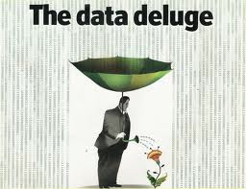
1. The Statistical Tragedy vs.
the (Big) Data Revolution
At the same time:
Data! Data!

Slide 6
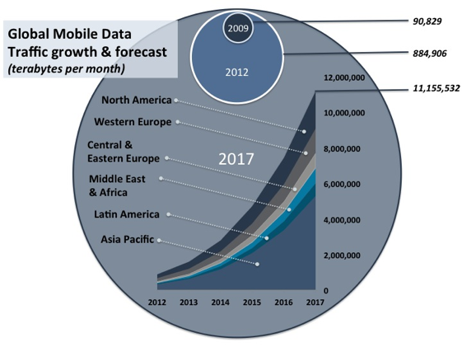
1. The Statistical Tragedy vs.
the (Big) Data Revolution
New data!
➔ Faster/cheaper/better ‘data’…? “(Big) Data Revolution”

Slide 7
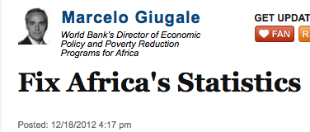
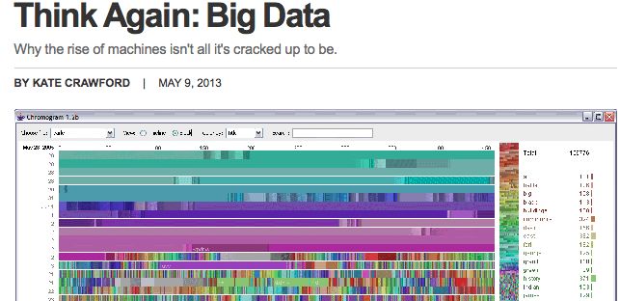
1. The Statistical Tragedy vs.
the (Big) Data Revolution
Some argue that Big Data can fix the “statistical tragedy” affecting poor countries
“Leapfrogging” of National Statistical systems?
Just help?
How?
Skeptics warn against Big ‘bad’ Data
Others point to more pressing priorities

Slide 8
But:
Are we asking the right question(s)?
Are we approaching them the right way?
Are we acting the way we should?
Who is we?

Slide 9
2. What is Big Data about—and not about?
Big Data is….data
Circumscribed here to “passively generated digital traces of human actions picked up by digital devices” (Letouzé, Meier and Vinck)
=
“Digital breadcrumbs” (Pentland) left behind (CDRs, CC transactions..)—hard little data particles left behind as people go about their daily lives
Open web data/social media data (Facebook, Twitter, blogs, online news, videos….)
Remote sensing (satellite, meters…)

Slide 10
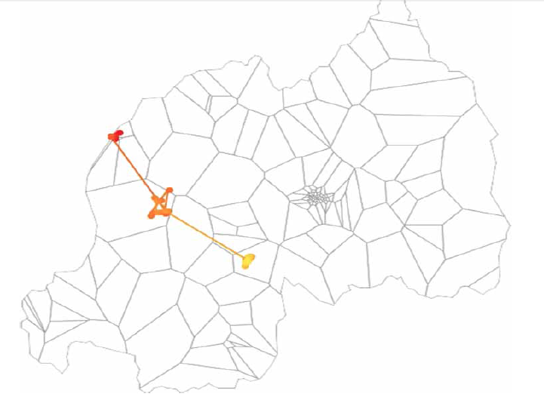
2. What is Big Data about—and not about?
But as data Big Data is more than big data—it doesn’t have to be big to be different—it’s a qualitative shift mostly
Big Data is not (primarily) about size/volume; it is about very many very small data produced by / about connected individuals (big data is small data—it can also be slow data)
Movement of an individual in
Rwanda over 4 years (Source J. Blumenstock)

Slide 11
2. What is Big Data about—and not about?
“I view Big Data as non-sampled data, characterized by the creation of databases from electronic sources whose primary purpose is something other than statistical inference”
Michael Horrigan, US BLS

Slide 12
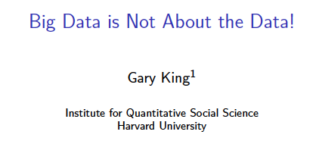
2. What is Big Data about—and not about?
More: “Big Data is not about the data” (Gary King)
It’s about the analytics—the insights gleaned from the data; and the necessary capacities to do so—human, technological
One step further: it’s about knowledge: getting near to the ‘true’ meaning of a Facebook status update; understanding how to use CDRs to study migration (sample biases, SIM Card not people..)
It’s about sharing and diffusion – visualizations
It’s highly ethnographic, and more

Slide 13
3. What is Official Statistics?
and why does it matter?
‘Data matters’: “You cannot manage what you cannot measure”.
Really?
Is the opposite true? (necessary & sufficient condition?)
‘Official statistics’
Definition?
Characterization?
Function(s)?

Slide 14
3. What is Official Statistics?
and why does it matter?
Just like Big Data, ‘Official statistics’ actually refers to 2 things:
Data produced by official bodies according to Principles ( and norms / statistical theory)
The systems producing/providing them – and perhaps more than data? Not just NSIs—many stats
It’s an industry that takes data and turns it into something else—it’s an ecosystem, a community:
like Big Data!
What input? What output? What outcome? What goal?..

Slide 15
3. What is Official Statistics?
and why does it matter?
“Official statistics provide an indispensable element in the information system of a democratic society, serving the Government, the economy and the public with data about the economic, demographic, social and environmental situation.”
1st Fundamental Principle of Official Statistics
…“official statistics assumes a key role in ensuring democracy and fostering social progress, by contributing to a shared framework of information concerning the reality in which we live”…[should]
”provide society with knowledge of itself, on which to base its own choices and evaluate the effects of political decisions”
Enrico Giovanni—President of Istat (in “Statistics 2.0”)

Slide 16
3. What is Official Statistics?
and why does it matter?
“Knowledge is power; statistics is democracy”
Olavi Niitamo—former DG of Statistics Finland (1978-92)
…but statistics is not reality…GDP is not reality; CPI is not reality; these are statistical constructs—shadows in the cave

Slide 17
3. What is Official Statistics?
and why does it matter?
If Big Data produces knowledge, if Official Statistics is about creating knowledge too..
What knowledge ‘about societies’ gets produced? How societies decide what is deemed worth knowing? What is deemed ‘official’?
Who ought to produce knowledge?
“Technological revolution has put an end to the monopolistic power that statistical institutes held until around twenty years ago” --that is fine/healthy – but increasing competition/new actors: Big Data and others
How is it used? By whom?

Slide 18
4. Where do we stand?
Early applications and current limitations
What have been early applications / adopters?
Several NSIs have started experimenting with Big Data
Statistics Netherlands: traffic data, sentiment analysis..
Statistics New Zealand: CDRs and moblity
US BLS: largely large admin data, inflation?
Eurostats started a HLG on Big Data
ISI session…
Others are more skeptical or unable:
Reputational risks? Technical challenges? Resources?

Slide 19
4. Where do we stand?
Early applications and current limitations
What have been early applications / adopters?
Several applications Big Data have made the headlines and seem relevant & get people excited:
GDP forecasting from outerspace
‘Nowcasting” (Hal Varian)
BPP and tracking inflation online
Public health (malaria spread, Google flue trends..)
Sentiment analysis?
Human mobility?
Human trafficking?
More (predictive policing..)

Slide 20
4. Where do we stand?
Early applications and current limitations
Examples

Slide 21
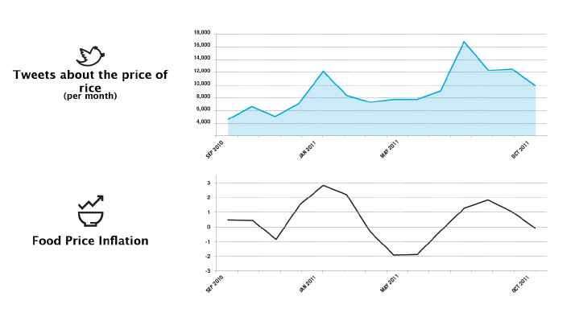
4. Where do we stand?
Early applications and current limitations
What have been early applications / adopters?
Source: Global Pulse and Crimson Hexagon

Slide 22
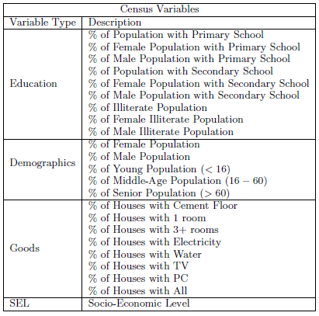
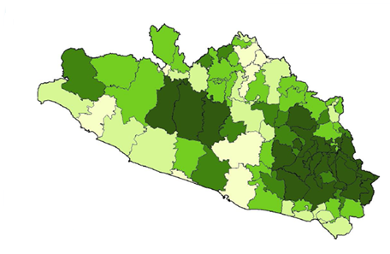
4. Where do we stand?
Early applications and current limitations
Deeper dive #1: “Prediction of Socio-Economic Levels Using Cell-Phone Records” (Telefonica research, 2011)
Telefonica team used their data to ‘predict’ SELs from Cell Phone Usage
National Statistical Institutes carry out surveys
Survey from “a major city in Latin America”
Predict the present (SELs for non-surveyed regions) and monitor the future (track changes over time)

Slide 23
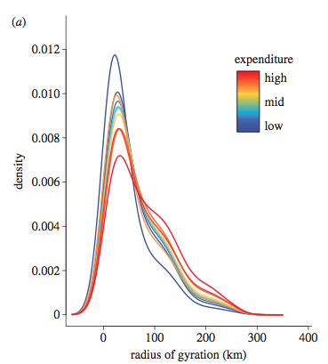
4. Where do we stand?
Early applications and current limitations
Deeper dive #2:Buckee, Eagle et al (2013): “The impact of biases in mobile phone ownership on estimates of human mobility”
—applicability to / similarity to poverty monitoring obvious
—Shows next frontier: methodologies
—directs attention to current limitations of terms and framing of current debates

Slide 24
4. Where do we stand?
Early applications and current limitations
Why / what limitations? Because the debate needs to be…
1. Broadened: it’s not a technical-technological issue; it’s a political issue—about knowledge, power, and democracy
Debate
2. Deepened: discussions often lack conceptual clarity and technical specificity
Conceptual clarity & technical specificity
Humanistic & democratic relevance

Slide 25
4. Where do we stand?
Early applications and current limitations
Implications and problems:
Quite complex/demanding methodologies/tools: ‘supervised machine learning’…hardly being discussed in “Data Revolution” talks—won’t come from the sky
Telefonica research: we don’t even know where it is—Data is not available, results are not replicable
Who creates the knowledge? Who can use it? has the capacities, the data? The power? Who asks the questions?
Here: all US PhDs, top academics/research institutions
How about NSIs/Os of Burundi, Niger, others?
Real risk of creating a “new digital divide” and a loss of accountability and oversight
Of course privacy—confidentiality—related to who owns and uses the data

Slide 26
4. Where do we stand?
Early applications and current limitations
Other problems:
Measurement:
Big Data may address part of the ‘measurement problem’ but it adds to it (and may change what we care to measure):
Consumption of data not recorded in GDP: is GDP missing an increasing surplus? (Brynjolfsson)
GDP invented in a data poor industrial era—will sound increasingly outdated and eventually lose its relevance
Other actors:
‘Quantified Self and Communities’ people who get data about themselves and act on them—’data matters’; how many people / who can do that?
Who is able to read complex charts and visualizations? Who has that literacy?

Slide 27
5. Where and how do we move
forward and ahead?
“All great evolutions in statistics happened through concrete applications in various fields” (M. Skaliotis, Eurostats)
Fulfilling the ‘promise’ of Big Data could start by working in a number of areas: poverty measurement and monitoring for instance to try and draw lessons with broader applicability
But solid understanding of what is at stake is required
The role of Official Statistics is to enhance knowledge about in societies – in ways that reflects and serves democratic principles and processes: diffusion channels and feedback loops
It has the legitimacy and the tools
This can and should be done using all relevant data
(re Principle 1)

Slide 28
5. Where and how do we move
forward and ahead?
It does not just mean doing the same better/faster/cheaper: it means doing things differently in a different era: knowledge-driven, user-centric, etc.
It does not mean hoping to get back to Statistik—of the Science of the State (about, by and for the state): there are multiple actors ‘out there’ that have been empowered and will demand, produce and use data about themselves and others—they are both demand and supply too—they have skills (designers)
It does mean that official statistics needs to engage and step up to be a key actor and avoid confusions and divisions—partner!
Other public actions are needed: data literacy, legal frameworks, with other actors (WEF-Orange)
I don’t believe much in certification—methods yes

Slide 29
5. Where and how do we move
forward and ahead?
1. Engage with citizens, communities, donors, private companies, academia—’revive’ and reinvent poverty measurement (for ex.) in the 21st century
2. reach out, collaborate, drawn lessons—innovate
21st Century Official Stats
Conceptual clarity & technical specificity
Humanistic & democratic relevance

Slide 30
5. Where and how do we move
forward and ahead?
Conceptual clarity & technical specificity
Methods
Partnerships
Strategy (NDSS, ISI, regional bodies)
Awareness/Advocacy
Humanistic & democratic relevance

Slide 31
5. Where and how do we move
forward and ahead?
Needed: feedback loops and mechanisms
Both external (policy) and internal (processes)
How to change course here?

Slide 32
Concluding remarks & suggestions
In Hal Varian famously said that “the sexiest job in the next 10 years would be statistician—and I am not kidding”. That has not happened yet—the sexiest job is data scientist
That could and should happen (datastician?): Official statistics can and must embrace Big Data—not just use the data—to create knowledge that reflects and serves democratic principles and processes. Be on the offensive.
You are not alone: lots of potential partners—academia, start-ups, individuals…and private sector
NDSS are a good place to start and the current international context offers an opportunity for international cooperation
What is needed is a radical evolution—in mentalities and methods

Slide 33
